Slide 1
BTP Presentation
Himanshu
18ME10024

Slide 2
Introduction
The Project consists of 3 Sections:
Creating a model for Detection of COVID-19 using Cough Recordings
Creating an App for implementing the Model
Comparison of First and Second Wave of COVID – 19

Slide 3
Introduction
Creating a COVID – 19 Cough Classifier using Machine Learning Techniques
Notes:
COVID-19 was first identified on 7 January 2020 in Wuhan, China; since then, much technological advancement is already in place to identify COVID-19 patients.
Here,I present a COVID-19 cough classifier that would help in contactless detection of COVID-19 patients by analysing their audio cough samples. The report demonstrates five machine learning classification models and combines those models into an ensemble model with 26 dominant features. The proposed method has been examined on both COVID-19 positive and healthy individuals' cough recordings. The results are promising, scoring accuracy of 99.3%, a sensitivity of 99% on validation data with an Area under the ROC curve of 0.97, all while maintaining interpretability.

Slide 4
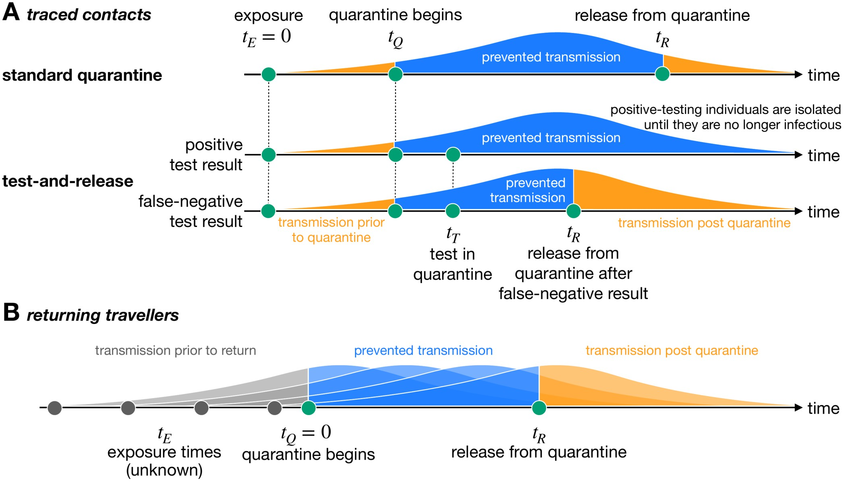
Motivation and Existing Solution
Increased rate of Testing has led to significant prevention in transmission of COVID 19
Frequent Testing can be really affective at catching COVID – 19 infections and potentially blocking transmission
Existing Solution: RTPCR Kits
Takes at least 24 hours to get results
Limited frequency of tests
Doesn’t account for new strains
Can be performed only by medical professionals
Notes:
Motivation and Existing solution: Studies have pointed out that Frequent COVID-19 testing is the key to efficient and early detection of COVID - 19(Pt 1 and 2). A study has even pointed out that Testing half the population weekly would drive the virus toward elimination within weeks – even if those tests are significantly less sensitive than clinical tests.
The image shown here shows the present scenario of how testing along with quarantine can potentially block transmission (even with false negative results):
1. Standard Quarantine + No Testing → here if the person is carrying the disease and is Asymptomatic, he will continue to transmit disease post quarantine
Now, with test results:
2. If a person has a positive test result, he will be isolated and hence the transmission is prevented.
3. If the test results is inaccurate and the person is wrongly detected as covid negative, keeping him in isolation till the test results will also lead to prevention in transmission.
The current testing method RTPCR has certain disadvantages as listed here:
1.
2.
3.
4.
Researchers say that when it comes to public health, it's better to have a less sensitive test with results today than a more sensitive one with results tomorrow(https://www.business-standard.com/article/current-affairs/frequent-rapid-testing-can-cripple-coronavirus-within-weeks-study-120112300270_1.html), Frequent Testing: https://www.journalofhospitalinfection.com/article/S0195-6701(21)00287-5/fulltext

Slide 5
Problem Statement
Can we make a COVID-19 detection method which:
Can give accurate test results in relatively less time?
Can be performed more frequently (hourly/daily)?
Can detect New Strains?
Can be performed without Medical Assistance?
Can be cheaper than RTPCR?
Notes:
The Existing solution which is the RTPCR has certain disadvantages as discussed in the previous slide, I try to address these questions in my COVID Detection model.
(The first Q is) 1. can we get accurate test results with reduced waiting time
2. Currently, experts have suggested that RTPCR tests be taken after a gap of at least 14 days. Here the question is Can we propose a method using which we can conduct tests more frequently? This can significantly bring down transmission as the potentially infected person can immediately isolate or get treated after he is diagnosed as covid positively.
3. New Strains of COVID 19 are not detected by RTPCR, can it be detected in any way?
4. Is there a way to perform the tests without having to visit testing centres or without any medical supervision?
5. RTPCRs are very costly with their price ranging from Rs 500 to 1500. Can we have tests which are more cost effective?
Source: https://health-desk.org/articles/how-many-days-after-exposure-should-one-be-tested-to-yield-the-most-accurate-results-and-with-which-test

Slide 6
Literature Review
In recent years, studies have suggested the use of acoustic features for identifying respiratory diseases in cough signals
Several studies have used Machine Learning techniques to process respiratory data and cough sounds
Researchers have also found some alteration in frequency characteristics of sound due to presence of COVID-19 in the lungs
Certain metrics like MFCCs(Mel Frequency Cepstral Coefficients), Zero Crossing Rate, Spectral Centroid have become state-of-the-art features to extract information out of sounds
Techniques like Deep Learning, Hidden Markov Models, Support Vector Machines have been used to detect cough sounds in voice recordings and to detect presence of COVID – 19 in cough sounds
Notes:
Pt 1.: This review attempts to summarize the vital studies in cough detection and identify diseases based on cough audio samples' features like frequency, duration, and intensity
Pt 4.: Which works on the sample principle of detecting the presence of certain frequency

Slide 7
Can we make a COVID-19 detection method which:
Can give accurate test results in relatively less time?
Can be performed more frequently (hourly/daily)?
Can detect Newdasdsfsafefjwpidms;k,. Strains?
Can be performed without Medical Assistance?
Can be cheaper than RTPCR?

Slide 8
Novelty
Usage of Interpretable Models and Libraries to understand the output of Individual Models
Using Ensemble learning to combine the output of these Models

Slide 9
Methodology

Slide 10
Data Used:
Can give accurate test results in relatively less time?
Can be performed more frequently (hourly/daily)?
Can detect New Strains?
Can be performed without Medical Assistance?
Can be cheaper than RTPCR?

Slide 11
Can we make a COVID-19 detection method which:
Can give accurate test results in relatively less time?
Can be performed more frequently (hourly/daily)?
Can detect New Strains?
Can be performed without Medical Assistance?
Can be cheaper than RTPCR?

Slide 12
Can we make a COVID-19 detection method which:
Can give accurate test results in relatively less time?
Can be performed more frequently (hourly/daily)?
Can detect New Strains?
Can be performed without Medical Assistance?
Can be cheaper than RTPCR?

Slide 13
Can we make a COVID-19 detection method which:
Can give accurate test results in relatively less time?
Can be performed more frequently (hourly/daily)?
Can detect New Strains?
Can be performed without Medical Assistance?
Can be cheaper than RTPCR?

